Slide 1
Blockchain Overview

Slide 2
How it all Came About
It all started with a short paper (8 pages, 8 references)
1-1-Satoshi Paper - Bitcoin.pdf
The paper was published by an anonymous person on an anonymous website in 2008
The title of the paper: “Bitcoin: A Peer-to-Peer Electronic Cash System”
The peer to peer network became operational in 2009
The technologies used in building the network is not new, but the innovation is in the way they have been put together: distributed protocols, cryptography, a decentralized distributed database (The ledger)

Slide 3
Reading through the Paper: Motivations & Objectives
purely peer-to-peer version of electronic cash that makes it possible to send payments directly from one party to another without going through a financial institution.
Use digital signatures to authorize payments
Prevent double spending – without the need for intermediate trust entities or organizations.
A solution to the double spending problem by using a peer-to-peer network
Timestamp transactions by hashing them into an ongoing chain of hash-based proof-of-work,
forming a record that cannot be changed without redoing the proof-of-work.

Slide 4
The Peer to Peer Network
A Peer to Peer (P2P) network is a network where groups of independent computers are interconnected, sharing data without the assistance of any centralized servers.
Usually deployed on top of the internet.
All nodes in this type of network are peers with equal responsibility within the network.
Since there are no special nodes in a P2P network, each peer is both a service provider and a consumer.

Slide 5
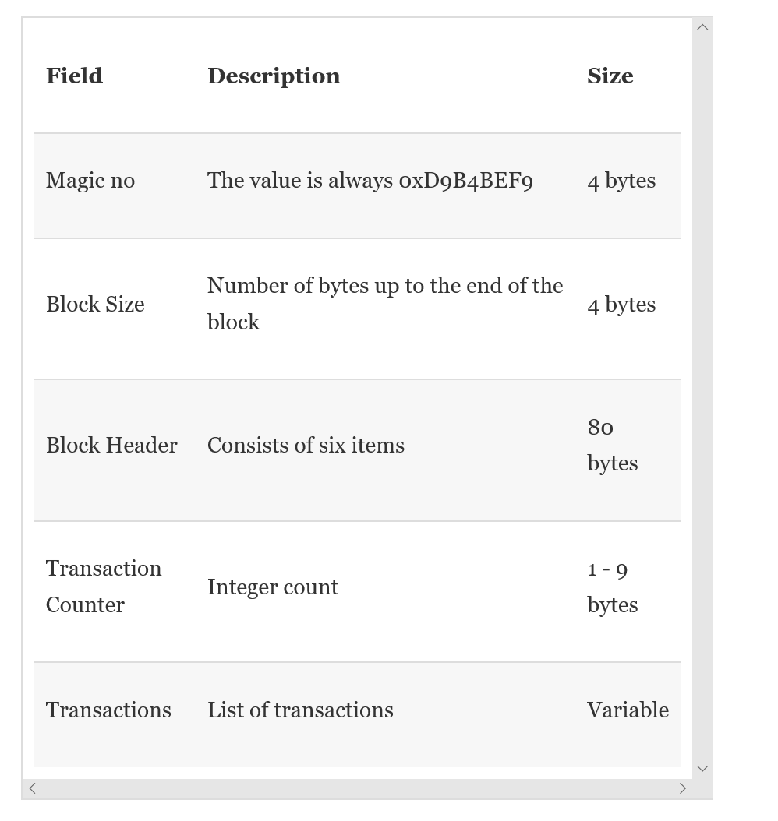
Block Structure in Bitcoin

Slide 6

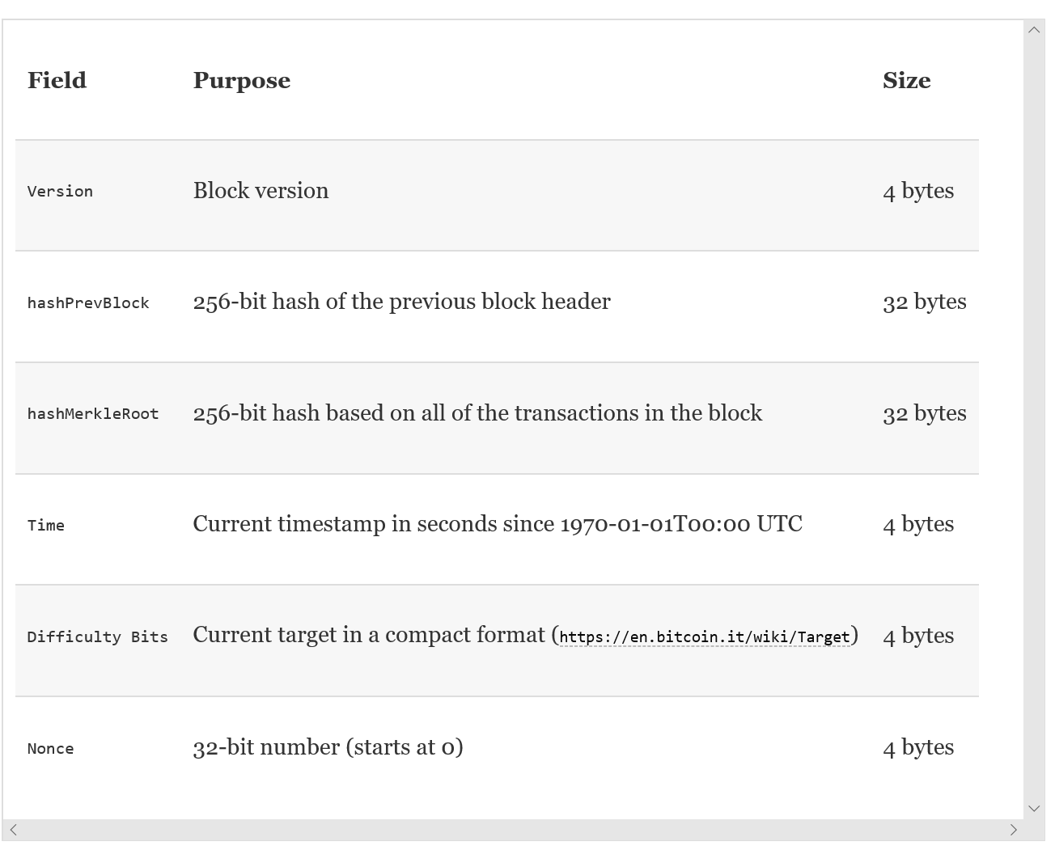
Block Header

Slide 7
The Hash Fields in the Header
Hash of the header of the previous block –this is the link between blocks
Hash of all transactions in the block – if any transaction is modified the hash will change, and the block will be rejected

Slide 8
Peer to Peer Network
All blockchain systems are deployed on a special type of virtual Peer to Peer network architectures on the Internet

Slide 9
Digital Signatures
Blockchain systems use public key cryptography to sign transactions and derive account addresses using user public keys

Slide 10
Double Spending
A common problem in trading and commerce systems
Traditionally solved using clearances and guarantees provided by financial institutions (takes time and costs a lot)

Slide 11
Transactions
Blockchain systems are distributed transactional systems
The transaction is the central entity in blockchain systems

Slide 12
Hash-Based Proof of Work
Refers to the consensus protocol used in blockchain systems
The Proof-of-Work consensus protocol is the major innovation in blockchain
Nodes compete to solve a hard problem (NP Complete) to confirm a block
All mining nodes compete to compute a special hash of all transactions in a block
The hash should satisfy a pre-specified format (the difficulty of the problem)

Slide 13
What is Blockchain?
“Blockchain at its core is a peer-to-peer distributed ledger that is cryptographically secure, append-only, immutable (extremely hard to change), and updateable only via consensus or agreement among peers.”
Source: “ Mastering Blockchain”

Slide 14
Many other Definitions
Sometimes the term “Blockchain” is used to refer to the underlying distributed secure “peer-to-peer” network
It is also used to refer to the consensus mechanism
However, the rising trend now is that the term Blockchain refers to the whole technology associated with cryptocurrency systems, including algorithms, data structures, underlying network …etc
Accordingly, the term “Blockchain Technology Systems” may be more appropriate

Slide 15
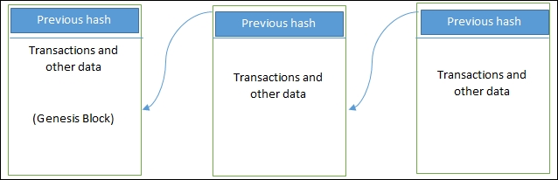
The Blockchain Structure
Linked Blocks

Slide 16
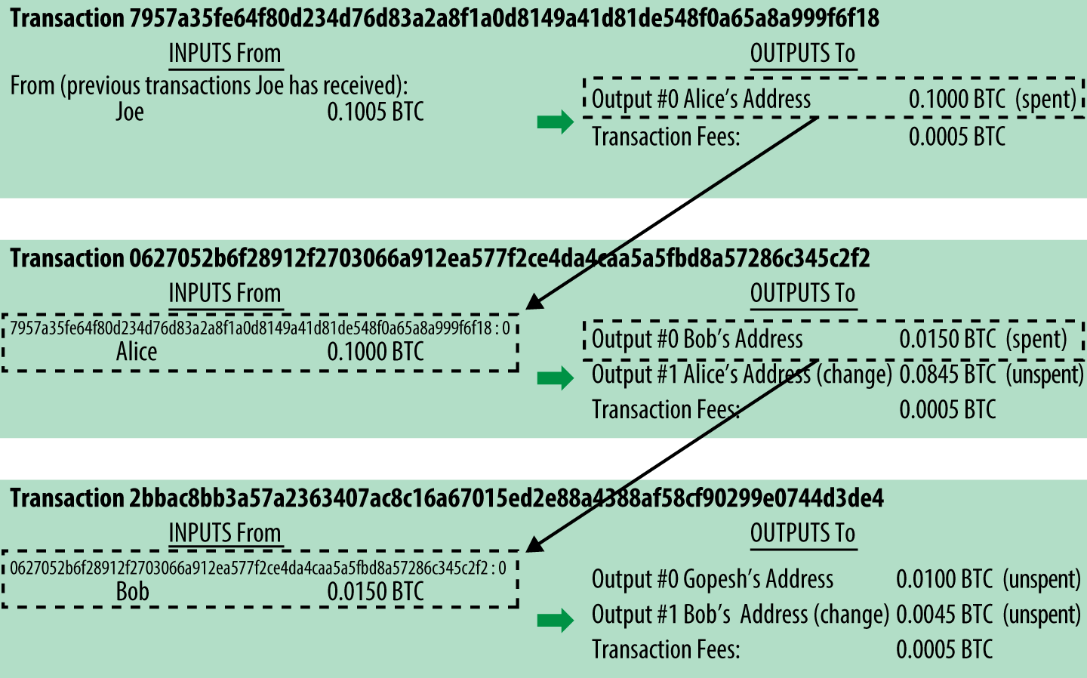
Some Example Transactions from Bitcoin

Slide 17
Block Structure
Size | Field | Description
4 bytes | Block Size | The size of the block, in bytes, following this field
80 bytes | Block Header | Several fields form the block header
1–9 bytes (VarInt) | Transaction Counter | How many transactions follow
Variable | Transactions | The transactions recorded in this block

Slide 18
How it Works?

Slide 19
Transaction Life Cycle
A user/sender generates a transaction using a wallet software or some other interface.
The wallet software signs the transaction using the sender's private key.
The transaction is broadcasted to the blockchain network using a flooding algorithm.
Mining nodes include this transaction in the next (candidate) block to be mined.
Mining starts on a new block once the last (previous) has been broadcasted by a (winner) node that succeeded in solving the “Proof of Work.

Slide 20
Transaction Life Cycle
The nodes verify the transaction and propagate the transaction further, and confirmation starts to generate.
Each mining node creates a block and add transactions to the block
Miner nodes compete to verify the block
The first node that confirms the block (through proof of work) broadcasts the confirmed block
All other nodes stop mining and focus on verifying the confirmed block
All transactions in the block are added to the ledger

Slide 21
The Mining Process
The Mining process is performed approximately, every 10 minutes in Bitcoin
All transactions generated during this period are packed into a “Block”, simultaneously on every mining node. (every node generates its version of the block – only the block of the winner node is propagated)
Miner nodes compete to mine that Block (every node tries to generate a cryptographic hash of the block header that matches a “target” solution pre-specified by the system.
This is usually a difficult (hard) problem that requires considerable time and computational resources. Solving this problem is the “Proof of Wok (POW)”, which strengthens the security of the network.

Slide 22
The Mining Process
Although thousands of nodes will be working in parallel (every 10 minutes, on average) to mine the current block, eventually there is only one winner: the first node to propagate the mined block.
On receiving the winning block, all other nodes stop working on the current block, and immediately start working on the next block.

Slide 23
Emergent Consensus
Consensus emerges as a result of four processes:
Independent verification of each transaction, by every full node, based on a list of criteria
Independent aggregation of those transactions into new blocks by mining nodes, coupled with demonstrated computation through a Proof-of-Work algorithm
Independent verification of the new blocks by every node and assembly into a chain
Acceptance by every node, of the chain with the most cumulative computation demonstrated through Proof-of-Work

Slide 24
Features
Decentralization: In simple terms, this means that the application or service continues to be available and usable even if a server or a group of servers on a network crashes or is not available. The service or application is deployed on a network in a way that no server has absolute control over data and execution; rather, each server has a current copy of data and execution logic.
Distributed: This means that any server or node on a network is connected to every other node on the network. Rather than having one-to-one or one-to-many connectivity between servers, servers have many-to-many connections with other servers.
Database: This refers to the location for storing durable data that can be accessed at any point in time. A database allows the storage and retrieval of data as functionality and also provides management functionalities to manage data efficiently, such as exporting, importing, backup, and restoration.

Slide 25
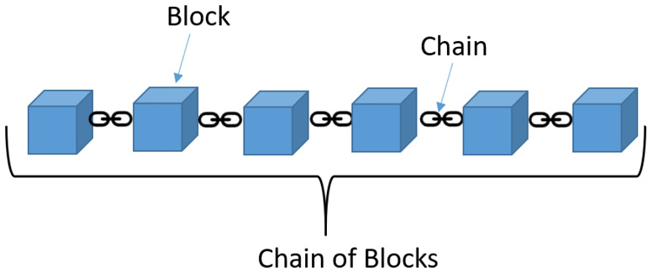
Architectutre

Slide 26
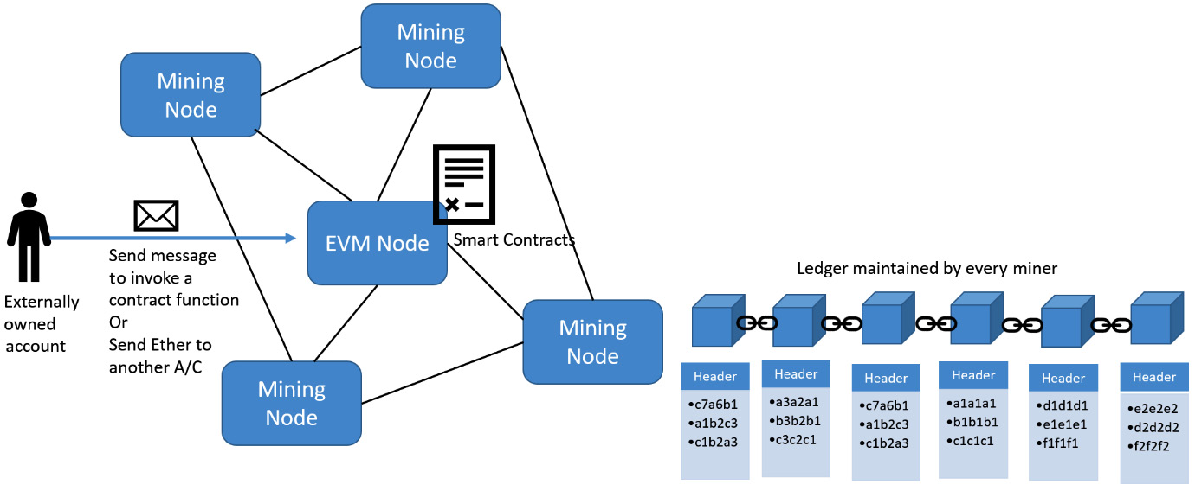
Architecture

